Slide 1
Open House
Language Arts
By
Sonya Turlington

Slide 2
Welcome to 6th grade!
How to reach me:
sonya.turlington@polk-fl.net is quickest (on school website, too)
Or call the school and leave a message: 863-420-2557
Want a conference? – Contact Leslie Brown in guidance and she will set one up with all your child’s teachers at one time.

Slide 3
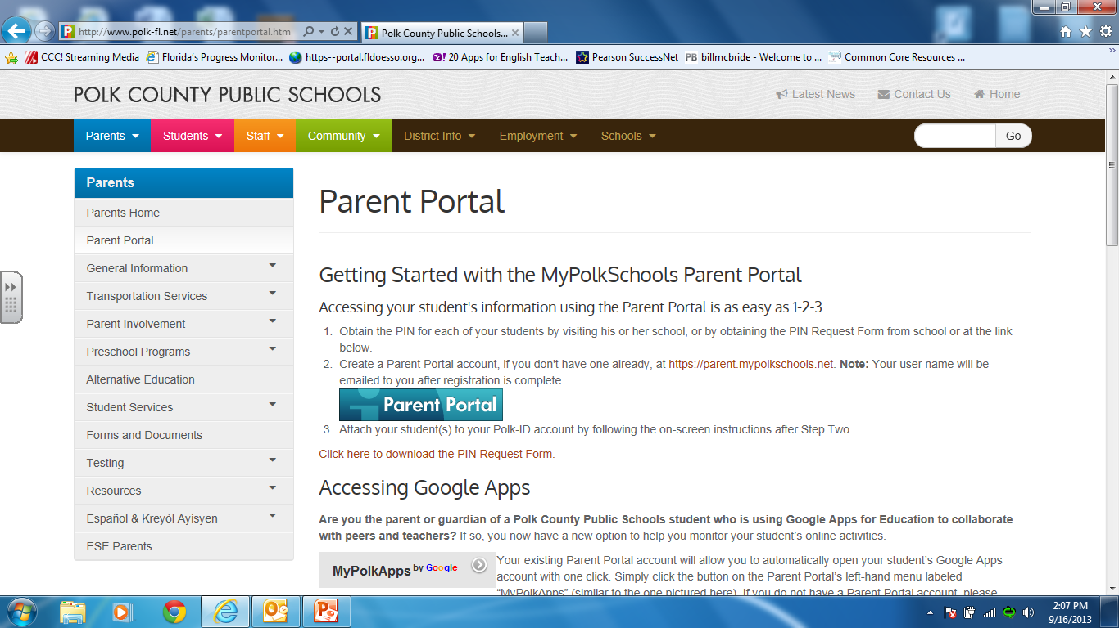
Parent Portal
1. Form from orientation
2. Check your email from Doug Jump (junk or spam?) for log-in information
3. Email will prompt you to generate a new password

Slide 4
Parent Portal
Shows your child’s grade in each class
Click on the numerical grade and you will see each assignment
0 U = They were here but didn’t turn it in
0 Z = They were absent but can and need to turn it in
X = They are allowed to skip that assignment for various reasons (could be a new student transfer grade)
You can set it up to notify you automatically (when your child earns a D or U) or check on Thursday so they can get what they need out of their locker on Friday, to do over the weekend!!! (Especially if they want to go to that sleep-over) ☺
Teacher comments – “Went Above and Beyond” or “They redid it”

Slide 5
Grades
Mistakes = Learning
Grades will reflect your child’s level of participation, understanding, and preparedness (homework)
Late work? – will result in a letter grade lost each day
It’s better to turn in something that is ½ done then nothing at all.

Slide 6
Language Arts
Reading-vocabulary, skills, close reading, analyzing text, comparing texts
Writing-Narrative, Informative, and Argumentative to sources; process writing; grammar
Listening-Group discussion (add to); podcasts (audio and video)
Speaking-discussing text, defending positions, explaining, and proving with evidence

Slide 7
Homework
Worksheets of reading, writing, vocabulary and grammar skills. They get participation points for completing it.
Finishing class assignments (only occasionally, when needed) because the goal is to build fluency and stamina during class time.
They are required to write every homework assignment into the agenda.
Instead of asking, “Did you do your homework?”…ask them to show it to you so you can see what they’re learning.

Slide 8
What can you do at home?
Read/sign agenda
Help them organize (calendar and papers)
Handwriting
Do not do their writing or typing for them
Practice typing or keyboarding skills as often as possible
Check parent portal (Ask them why they have a zero and follow up until it’s turned in)
Have them check student portal

Slide 9
FSA Assessment
On the writing portion, they will be given 3-4 texts to read and then given a prompt where they inform about the topic or argue a claim about the topic while showing text evidence.
(click title above in slide show mode)

Slide 10
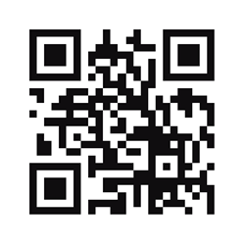
Our Class Website
http://srturlington.weebly.com/

Slide 11
Thanks for coming!!

